Slide 1
DAMO 510 Predictive Analytics
Module 05
Working with categorical variables

Slide 2
Quick Review of Module 4
Data Transformations
Power Transformation:In power transformation each data point is raised to a power. This transformation is used to stabilize variance, make data distribution look like normal and to improve the linearity in statistical modeling
Log Transformation : In Log transformation, each value in a dataset is replaced with its logarithm. It's often used to address skewness in data, make patterns more visible, and help statistical models meet their assumptions.
Box-cox Transformation: This transformation is often used to make the data more look like a normal distribution

Slide 3
Quick Review of Module 4
Non-Linear Regression Using Transformations
Non-linear regression models the relationship between a dependent variable and independent variables using a non-linear function.
We use data transformations techniques to fit a linear model on a non-linear data. Commonly used transformations include logarithmic transformation and box-cox transformations of the variables to linearize relationships among the variables.

Slide 4
Categorical Variables
We often see categorical variables, also known as qualitative variables, in our datasets. They represent qualitative data, such as gender, region, hierarchy of professor ranks in a university and product type.
They are used in analyzing the trend and pattern in the data. For instance, to analyze the spread of the disease in different region of the world.
They can also be used to identify the pattern of sales in different regions of interest.

Slide 5
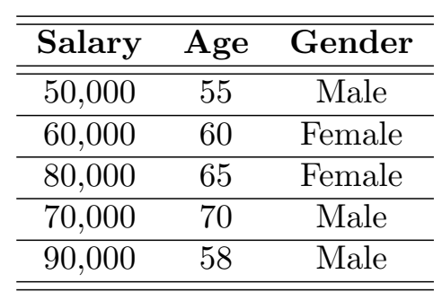
Dealing with Categorical Variables
Consider a dataset with categorical variable “ Gender”
having two categories “ Male” and “Female”. The aim is to predict
the Salary from independent variables “ Age” and “Gender”.
However, first we have to deal with the categorical variable
“ Gender”

Slide 6
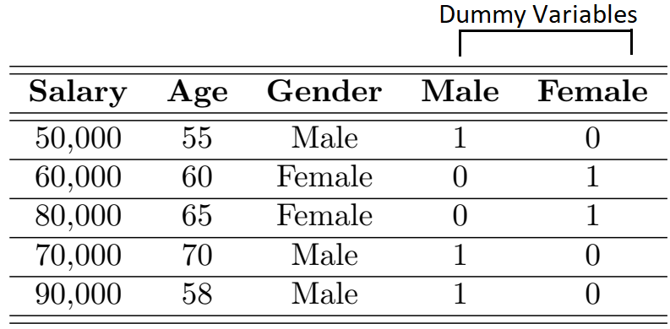
Dealing with Categorical Variables
In order to deal with categorical variables, we need to create
dummy variables or binary variables for two categories
“ Male” and “Female” as shown below.

Slide 7

Dealing with Categorical Variables
Regression Equation in terms of dummy Variable is given by

Slide 8
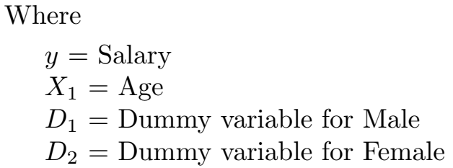
Dealing with Categorical Variables
Regression Equation in terms of dummy Variable is given by

Slide 9
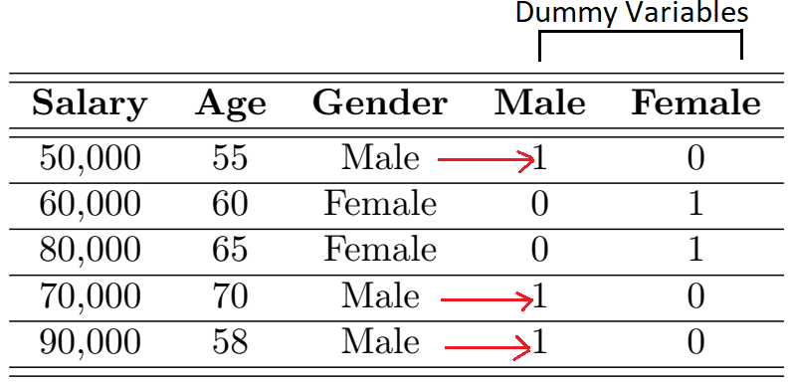

Dealing with Categorical Variables
We observe that the sum of the dummy variables for “Male” and
“Female” is 1 for all the samples of dataset.

Slide 10

Dealing with Categorical Variables
We observe that the sum of the dummy variables for “Male” and
“Female” is 1 for all the samples of dataset.
and
From the above equations, we can clearly see that two dummy
variables are highly correlated and they depend upon each
other and thus violating the condition that the independent
variables for Regression Analysis should be uncorrelated.

Slide 11
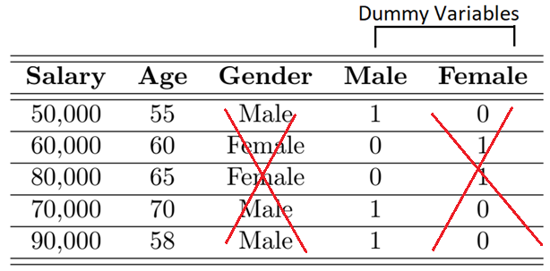
Dealing with Categorical Variables
High Correlation between dummy variables leads to the problem
of multicollinearity OR dummy variable trap.
To avoid dummy variable trap, we need to drop one of the dummy
variable

Slide 12
Dealing with Categorical Variables
Male = 1, means that the individual is “Male”
Male = 0, means that the individual is “Female”

Slide 13
Explanation with codes

Slide 14
Class Activity
Students are required to open python file ClassActivity_Moduele05.ipynb.
A dataset “Salaries.csv” has already been imported in the file.
Students are required to create dummy variables for categorical features and perform Multi-linear Regression to predict the “salary” from the given independent features.
Multi-linear Regression should be performed using both Statistical and Machine Learning approaches.

Slide 15
Thank you !

Slide 16
Thank you !

